Slide 1
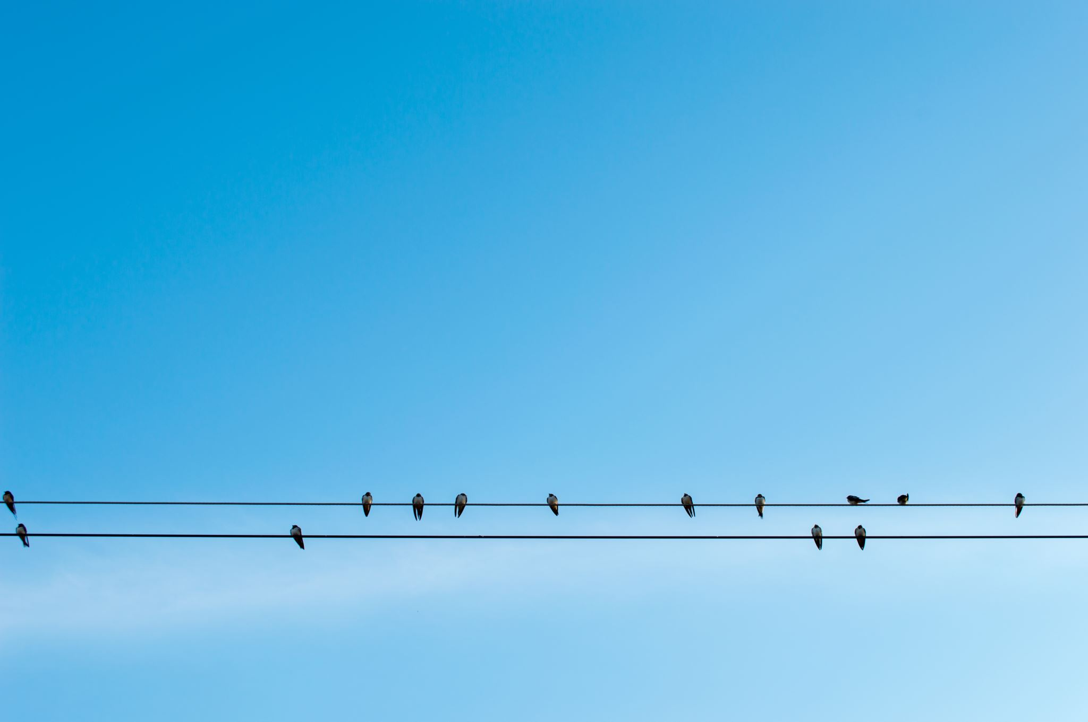
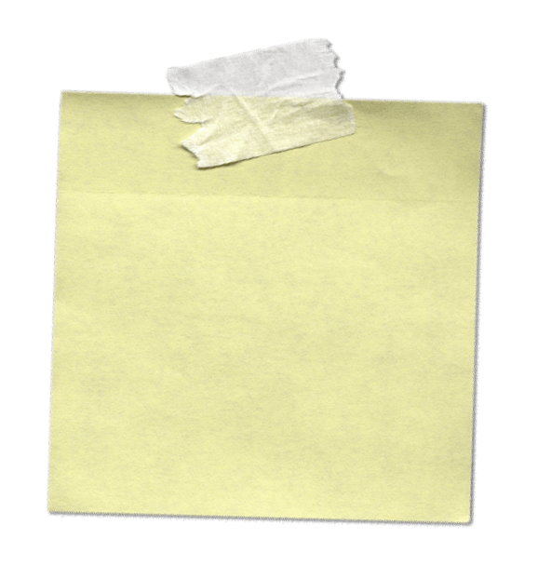
Case
Communications
…your most
important skillset.
whhender
July 2020
.

Slide 2
We’ve talked about troubleshooting process, handoff, case notes, even how to stay sane as a support engineer. During all these presentations, we’ve talked about communications too.

Slide 3
Follow your customer’s lead…
Respect your customer’s time…
Customer
focus.
Set expectations.
Be clear.

Slide 4
Most cases aren’t make or break on technical knowledge.
All your customers want is for you to understand their problem and be dedicated to fixing it.

Slide 5
Think about your own customer service experiences…

Slide 6
Agenda:
Good Communications
Professional Emails
Professional Calls
Call or Email?
FQR (First Quality Response)
LQR (Last Quality Response)

Slide 7
This is all on the wiki!
Search:
‘communication’

Slide 8
‘Good’ Communications Are Always
Customer Focused
When talking to a customer focus on their problem and not your case.

Slide 9
o
x
For Example:
During Handoff
Hello Ann, We are coming to the end of the workday, and unless you have someone who can continue working the case in APAC hours, we cannot leave this case at Severity A. We must reduce to B and pick up again tomorrow.
Hello Ann, We are coming to the end of the workday, and I wanted to know how you would like to proceed. My hours start at 8am and we can pick up again at that time, or I can find an engineer who can continue working with you and your team this evening.

Slide 10
So customer focus means:
Follow your customer’s lead in a case.
Understand their needs and concerns.
Make internal policy work for what your customer needs.
Focus your communications on what your customer needs and needs to know.
Personalize.
Provide motivation - (why do you need what you’re asking for.)

Slide 11
Professional Emails
Your primary communication with your customer.

Slide 12
Professional Emails
Every customer email should: 1. Have a header.
2. Have a body.
3. Contain action plan, request, next contact, or status.
4. Have a full signature. 5. Have been checked for spelling and grammar errors.

Slide 13
Email Headers
Don’t treat emails like texts, even if your customer does.
Good Afternoon,
Hello All,
Hello Olga,

Slide 14
Email Body
Don’t treat emails like texts, even if your customer does.
Personalize your emails and include current steps, next steps, and any relevant information. Even for short follow up emails!

Slide 15
o
x
For Example:
Following Up
Hello Vimal, I just wanted to follow up with you to see if you received my last email and check how things are going with the steps we provided.
Please let us know if you have any questions or need any assistance implementing the steps. We look forward to hearing from you.
Have you tried the steps I gave you?

Slide 16
o
x
For Example:
Following Up
Hello William, I wanted to touch base with you about collecting the data we requested and ask if you had any questions or if you had encountered any issues. Let us know if we can be of any assistance. We look forward to receiving and reviewing the data.
Hello William,
Can you please send us the data we requested?

Slide 17
Be Careful with ‘ Please’
Can you please send us the data we requested?
Remember, your customer can’t read your tone and for a case that’s already going poorly or for a customer having a bad day, it’s easy to read in sarcasm…

Slide 18
See the Customer Focus?
o
x
For Example:
Following Up
Hello William, I wanted to touch base with you about collecting the data we requested and ask if you had any questions or if you had encountered any issues. Let us know if we can be of any assistance. We look forward to receiving and reviewing the data.
Hello William,
Can you please send us the data we requested?

Slide 19
Action Plan in Email
‘Good’ Case Notes allow anyone To Understand
- within 15 minutes -
the status, impact, next steps, and research done on a case.
Your emails should be similar!
‘Good’ Emails allow your customer to understand
- within 5 minutes -
the current Status, Next Steps, and When they’ll hear from you Next.

Slide 20
Action Plan in Email
‘Good’ Emails allow your customer to understand
- within 5 minutes -
the current Status, Next Steps, and When they’ll hear from you Next.
Hello Kara,
I just wanted to give you an update: I am still investigating the issue. This looks like an issue on the ADLS backend so I am now working with the product team to identify and resolve the issue. In the meantime, retrying your failed jobs may see success for those jobs while we investigate the issue.
I will follow up again with your team by 3pm EST to give you a status update, but if I have any further information before then, I’ll let you know. As before, if there are any questions I can answer for you in the meantime, please reach out.

Slide 21
Action Plan in Email
‘Good’ Emails allow your customer to understand
- within 5 minutes -
the current Status, Next Steps, and When they’ll hear from you Next.
Hello Kara,
I just wanted to give you an update: I am still investigating the issue. This looks like an issue on the ADLS backend so I am now working with the product team to identify and resolve the issue. In the meantime, retrying your failed jobs may see success for those jobs while we investigate the issue.
I will follow up again with your team by 3pm EST to give you a status update, but if I have any further information before then, I’ll let you know. As before, if there are any questions I can answer for you in the meantime, please reach out.

Slide 22

Email Signature
Whitney Henderson
whhender@microsoft.com
Sr Technical Advisor Work Hours: M-F 8am-5pm EST
Data Movement Office: +1 (980) 7767642 X67642
Manager: Lee Pauling - lepaulin@microsoft.com
Service Desk does not automatically include your signature, so copy and paste that in.

Slide 23
Professional Emails
Remember:
Use spell check. Check for missing punctuation. Capitalize your sentences.

Slide 24
Do what you say you will…
This is obvious, but…
When you get bogged down in cases it can be easy to let things slide.
Set Honest/Reasonable timelines for yourself and communicate those. If your customer pushes back, that’s good! Work with them to meet their needs.
If you set a deadline and can’t meet it, reach out to the customer in time to tell them you can’t make it and when they can expect the next communication.

Slide 25
Make Your Emails Clear
…you will notice, no one reads.
Keep your emails short.
Use lists for important information.
Put critical information at the top of the email.
@ specific users or underline important information.

Slide 26
Practice Patience
You will write beautiful emails that
your customers do not read.
It will be annoying.
Be patient and professional. Repeat yourself respectfully.
Consider a phone call.

Slide 27
Email Communications Should Always Be:
Professional – headers, bodies, signatures, and courtesy.
Useful – action plans, next steps, next contact.
Clear – spell check, lists, be direct.
Concise – read in less than 5 minutes.

Slide 28
Professional Calls
Communication for clarity, speed, and a personal touch.

Slide 29
Professional Phone Calls
Every customer call should: 1. Have been prepared in advance.
2. Be Calm
3. Be Courteous
4. Take a break when you aren’t getting anywhere.

Slide 30
Planning a Call
What information do you need? What needs to be done to gather it?
What steps need to be taken?
What information do you need to convey.
If you’ve covered everything, try to end the call.

Slide 31
Why Plan a Call?
You don’t forget anything important…
Respect your customer’s time, and your time.
Stay on task.

Slide 32
How to Rescue a ‘Bad’ Call
Stay Calm.
Return to your planned to-do list.
Ask your customer for their current priorities.
Create action plan/next steps with customer.
Take time to research.

Slide 33
Professional Phone Calls
How to talk like a professional.
Smile while talking!
Be courteous – ask for your customers needs and work with them.
Answer the phone professionally.
Leave Professional Messages Put important info in an email.
Hello, this is Whitney Henderson with Microsoft Support.
Do not leave critical or personal information in a voicemail. Ever.

Slide 34
Professional Phone Calls
You don’t have to have every answer. Tell them you will follow up on that.
If you’re not getting anywhere, take a break. End the call if you can and set up another time to talk.
Be clear, set honest expectations.
Ask for clarity if you don’t understand.
Stay calm in front of your customer.
Always follow phone calls with an email.

Slide 35
Most cases aren’t make or break on technical knowledge.
All your customers want is for you to understand their problem and be dedicated to fixing it.

Slide 36
How do you know when to call or email?
Always call if
your customer requests it.
First communication preferences.
Customer temperature.
Too many emails back and forth.
Problem/Troubleshooting Type

Slide 37
Phone Communications Should Always Be:
Professional – calm, professional, courteous.
Useful – prepared, directed, ended when becoming long-winded.
Clear – prepared, honest, knowledgeable.
Concise – prepared.

Slide 38
So we’ve covered how to be generally professional on calls and emails.
But let’s talk about the two most important communications on a case:
The First & The Last
Stay customer focused and you won’t go wrong.

Slide 39
FQR First Quality Response
Your first communication with your customer.
Or, your first email with your customer…

Slide 40
First Quality Response
Ensure that the first engagement with the customer is done by an Engineer that is prepared, personalizes a response, and intends to make progress towards resolving the customer’s issue.
(We call this the 3 P's: Prepared, Personalized, Progress)
Your first communication should move your case forward or at very least, tell your customer when they will hear from you.

Slide 41
First Quality Response is a relatively new practice…
We used to use scope templates. These were intended to make sure we understood the customers email, answered them on time, and that customers had the same experience across teams.
All good intentions! But…

Slide 42
Customers had a lot of
‘junk’ emails from us…
Templates can help make sure that our customers receive the same service across all teams and they help make sure we hit our goals…
But they can also get repetitive, and often don’t provide your customer good information.
Remember:
Customer focus is key!

Slide 43
Prepared: Personalized: Progress:
Research your customer’s issue before you reach out to them. Try to fully understand the issue and consider potential root causes.
Use your customer’s name, call out your customer’s issue specifically, and match their sense of urgency.
Provide clear next steps for you and your customer, and a timeframe in which they will be completed, if possible.

Slide 44
o
x
For Example:
FQR
Hello Srinivas,
My name is Whitney and I will be taking your case.
You agree that this case will be considered resolved if one of the following conditions are met:
1. We have found a solution to your problem of permissions
2. If we give you a workaround that will help solve your business need.
3. Show you that what you are attempting to do is not a Microsoft supported configuration.
4. The issue you are experiencing is intended behavior of the product. …
Hello Srinivas,
My name is Whitney and I will be working with you on case <case number>. If you need to reach out, you can find my contact information in my signature. I see you’re having a permissions problem with Azure Data Lake store. Thank you for providing the full error message! I was able to look on the backend and I can see your request is failing for path <path> and user <user>. What permissions do you have assigned …

Slide 45
o
x
For Example:
Short SLA
Hello Pedro,
I am currently looking into your case. You will hear back from me soon.
Best, Whitney
Hello Pedro,
My name is Whitney and I will be working with you on case <case number>. If you need to reach out, you can find my contact information in my signature. I see you’re having a permissions problem with Azure Data Lake store. Thank you for providing the full error message! I am currently investigating the issue on the backend and will reach out to you in 2 hours (time) at the latest with next steps. If there is anything you need in the meantime, please reach out.

Slide 46
If you make FQR on a call:
Research and prepare next steps and what information you need to gather. First thing on the call, ask your customer to describe the issue to you, then repeat the key points back to them.
End the call when there are not clear next steps.
Follow up with a good FQR email.

Slide 47
LQR Last Quality Response
Your last communication with your customer.
Or, your last email with your customer…

Slide 48
Last Quality Response
Ensure that the last communication with your customer leaves a good impression and leaves them feeling knowledgeable about the issue and what they can do if they encounter the issue again. Equip your customer with knowledge!
You can rescue a ‘bad’ case with a great last quality response.

Slide 49
Last Quality Response
Thanks your customer for their time, effort, and for contacting Microsoft Support. 2. Provides full information about issue, why it occurred, and how it was resolved. 3. Reminds the customer they may get a survey and requests that they fill it out. 4. Reminds them if they have any other issues, to reach out to us again.

Slide 50
These are mostly personal touches.
Match your customer’s tone during the case to leave a good last impression, and tailor your response to your customer’s experience. Templates are helpful but respect your customer relationship and try not to provide a canned response. Just remember to remain professional and courteous.

Slide 51
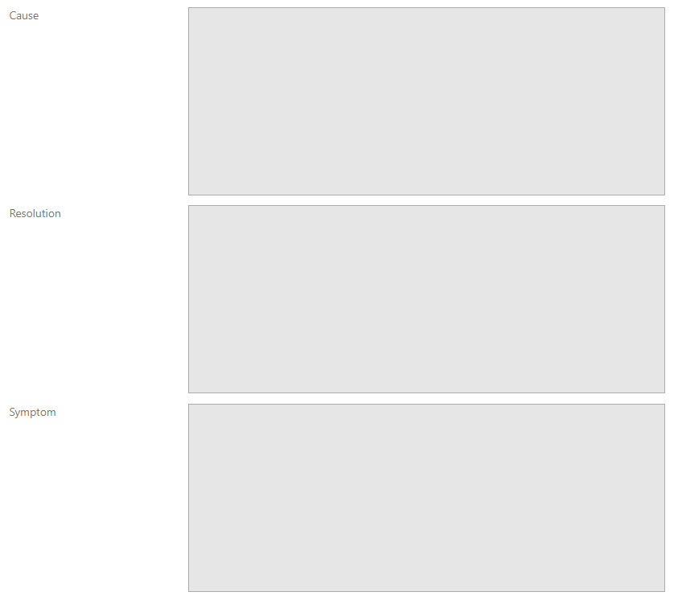
LQR – Technical Information
Use your closing ‘Service Desk’ information as a guide!
Your LQR should include:
Summary of the issue.
Why the issue occurred.
How we resolved it. But don’t forget to personalize.

Slide 52
LQR – Technical Information
Your case notes are peer focused.
Use your closing ‘Service Desk’ information as a guide!
Your LQR should include:
Summary of the issue.
Why the issue occurred.
How we resolved it. But don’t forget to personalize.
Your LQR is customer focused.
They may need to be different.

Slide 53
For Example:
Case Notes
Customer Mail
Cause: Customer Mistake – Incorrect Permissions Applied. Resolution:
Resolved by adding –X permission for user on Root folder. <Documentation> Symptom:
Though customer has read permissions on a file in the data lake, they are unable to browse in the portal and receive an access error.
You were unable to browse the data lake in the portal and were receiving an access error.
We were able to resolve the issue by applying –x permissions for your user on the root folder. This resolved the issue because in order to list files in a folder, at least –X permission is needed, and ‘browsing’ in the portal is listing out the files and folders in your data lake. You can read more about it here <documentation>.

Slide 54
o
x
For Example:
LQR
Hello Mary,
Thank you for your time on our call today! Since we resolved the issue, I will move forward with closing out the case this afternoon. If you have any additional questions, please reach out to us again! Thank you for choosing Microsoft Support.
Best,
Whitney
Hello Mary,
Thank you for your time on our call today.
We were able to address the performance of your copy pipeline. You were seeing some slow throughput…. (full description of error). We noticed you were using low parallelism and increased parallelism for the job and your data moved much more quickly. Here’s some documentation talking about parallelism: <docs> ……

Slide 55
Don’t forget:
In your last email to your customer, remind them that they may receive a survey or that they can reach out to you directly with feedback:
Please note: When this case is closed you may receive a survey, and I ask that that you please fill it out! Your feedback is very important to us and we use it to continually improve our service.
At any time if you would like to discuss any feedback you can also contact me directly or my manager using the contact information below. ​

Slide 56
Reach out to your manager!
If your customer is really happy…
Or really upset…
Our managers regularly reach out to customers to turn around cases with an upset customer or to make things even better with a customer that had a great experience!
Feedback really is important!

Slide 57
We’ve covered emails, calls, FQR and LQR…
But there is always something to learn with case communications.
Remember, this is your most important skillset for a reason.
For handoff, unresponsive customers, unresolved cases, duplicate cases, automatic replies, and lifecycles…
…use the wiki.

Slide 58
You’re gonna make mistakes.
This is something you will get better at with time.
Sometimes you won’t
Know what to say. You’ll sneeze into your mic.
Sometimes you won’t know how to make a customer happy.
It’s Okay.

Slide 59
Just Remember:
Be Professional
Make ALL Communications Useful
Be Clear
Be Concise
Be Prepared
*
*
Be Customer
Focused
*

Slide 60
Search:
‘communication’
This is all on the wiki!
We even have some great templates to get you started!

